Slide 1
ECE411 Group 2
Final Presentation
Temperature Controlled Fan
Group Members: Melinda Van
Reem Abdo
Qiuren Wang
Yusheng Tian
Notes:
Team member #1

Slide 2
Agenda
Intro
Hardware
Software
Testing/verification
Conclusion/reflection
Notes:
Team member #1

Slide 3
Introduction - Problem/Needs
There are 1.2 billion people with no electricity in the world and most of people live in climates with severe heat climates. For these places, air conditioning or even a fan is hard to come. A low-cost solar-powered fan will be helpful for those in need of air currents for cooling or ventilation.
According to International Energy Agency, “globally 1.2 billion people are without access to electricity...more than 95% of these people are either in sub-Saharan Africa or developing Asia, and around 80% are in rural areas.” More so don’t have constant or dependable electricity. This is evidence that this is a must needed product for which people will benefit from.
Notes:
Team member #1

Slide 4
Introduction - Design Decisions/Goals
Affordable
Reliable, works anytime needed
Portable/lightweight
Easy to assemble and use
Relatively straightforward to design, implement/build and test
Notes:
Team member #1

Slide 5
Design Objectives
Programmed microcontroller automatically controls a desktop fan according to the ambient temperature input from the sensor
Display the current temperature value on the 2-digit seven segment display
Notes:
Team member #1

Slide 6
Alternatives
What similar products have been made?
Portable AC
Portable (USB) Fans
Why is our design better (at some points)?
Cheaper and lighter, more portable as well
Smarter, temperature controlled to save unnecessary battery usage
Notes:
Team member #1

Slide 7
Design Specs and Requirements
What does the user need to operate it?
9v battery
No need to rely on the sun for power, works even on rainy/cloudy day
Is it easy to use?
Yes, no button needed to push, everything automatically controlled
Does it cost a lot to make or manufacture?
Relatively cheap for a smart cooling/ventilation system
Notes:
Team member #1

Slide 8
Design Approach
Hardware
Use parts that are easy to find
Design simple circuit for easy implementation and debugging later
Software
Arduino IDE, perfect for beginners like us to program the microcontroller
Language/syntax similar to C/C++
Notes:
Team member #1

Slide 9
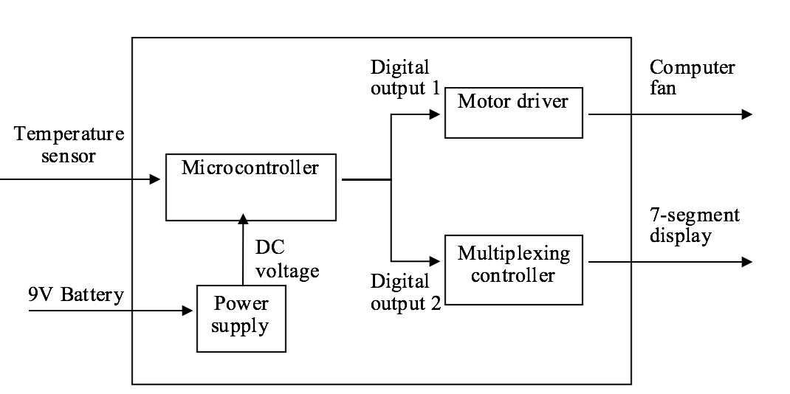
Hardware: Block diagram overview
Notes:
Team member #2

Slide 10
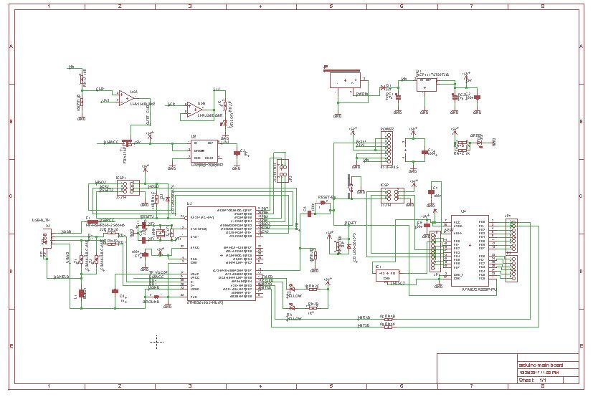
Hardware Schematic: v1.0
Notes:
Team member #2

Slide 11
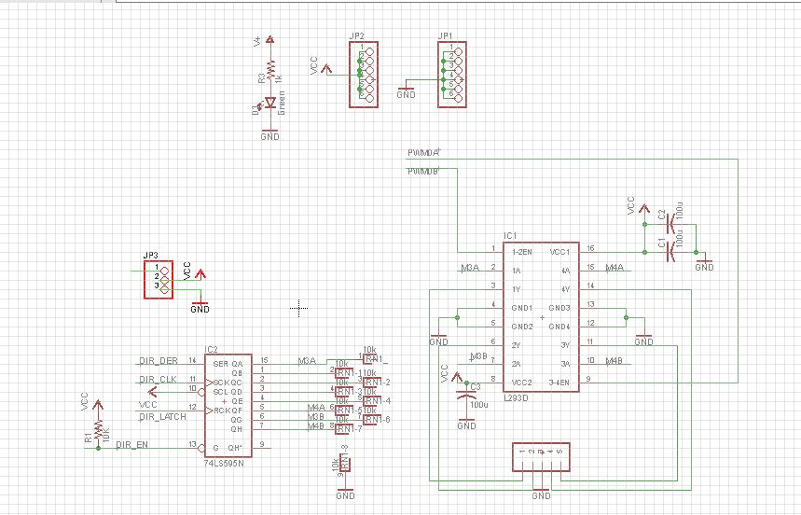
Hardware Schematic: v1.0

Slide 12
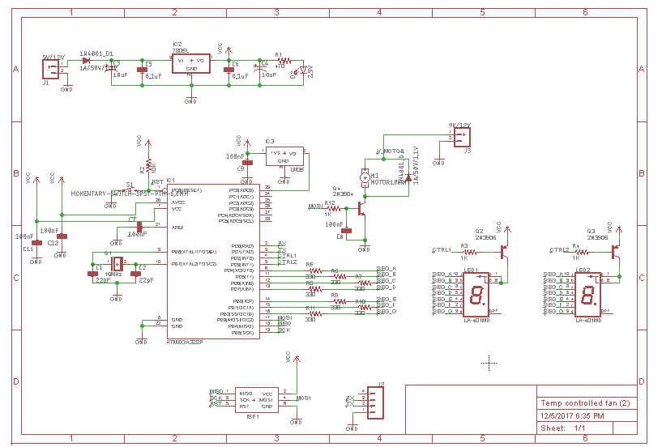
Hardware Schematic: v2.0
Notes:
Team member #2

Slide 13
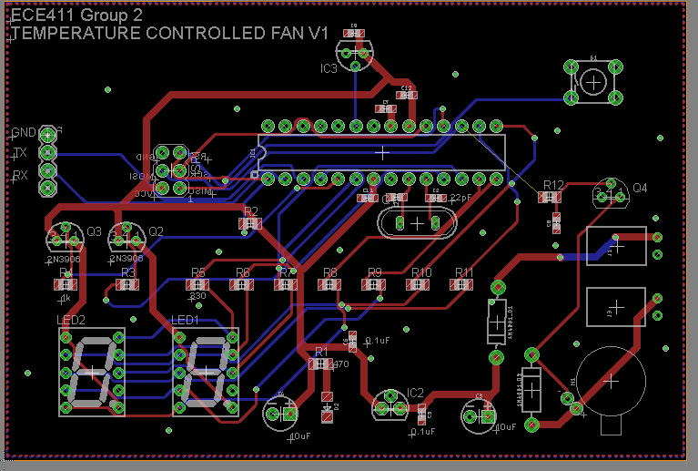
Hardware: Board layout
Notes:
Team member #2

Slide 14
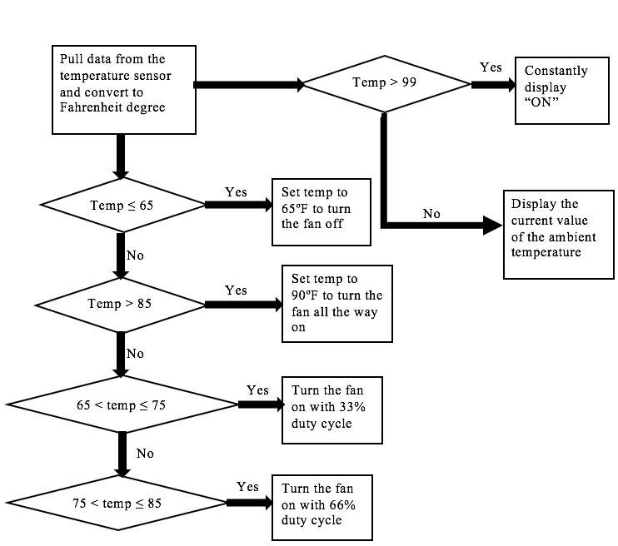
Software: Flowchart for the Code
Notes:
Team member #3

Slide 15
IP and Prior Work
https://circuitdigest.com/microcontroller-projects/automatic-temperature-controlled-fan-project
https://www.arduino.cc/en/Tutorial/ArduinoToBreadboard
https://www.youtube.com/watch?v=iZI1GjCvIiw
https://www.citylab.com/life/2013/06/where-billion-people-still-live-without-electricity/5807/
Notes:
Team member #3

Slide 16
Challenges
The timing for the two-7 segment display didn’t work well
Getting the motor and 7 segment display to work at the same time
Boot loading the chip
Finding the correct components
Finding time for all of us to meet up

Slide 17
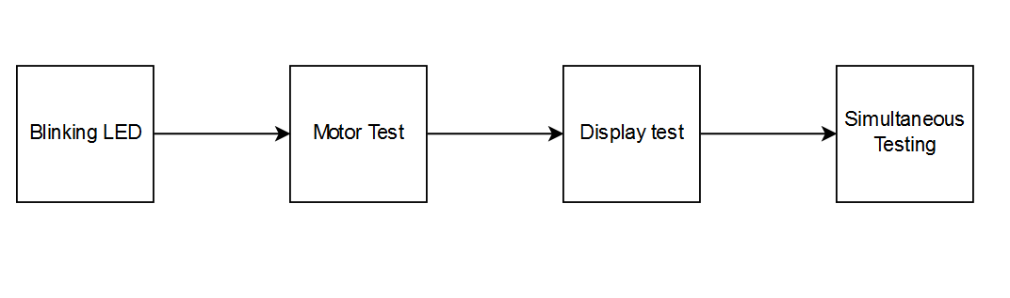
Test Plan
Brought up the power supply to ensure the output voltage to be a constant 5V dc
Problems: loose connection at the header of the battery due to using incorrect pin header in the EagleCAD library
Assembled the MCU and burned the Arduino bootloader to the chip, performed simple blinking LED test to ensure the bootloader burned successfully
Completed soldering the rest of the board and performed the motor test and the seven segment display test
Problems: battery doesn’t provide enough power to start the motor, therefore, an initial push to start the motor is required

Slide 18
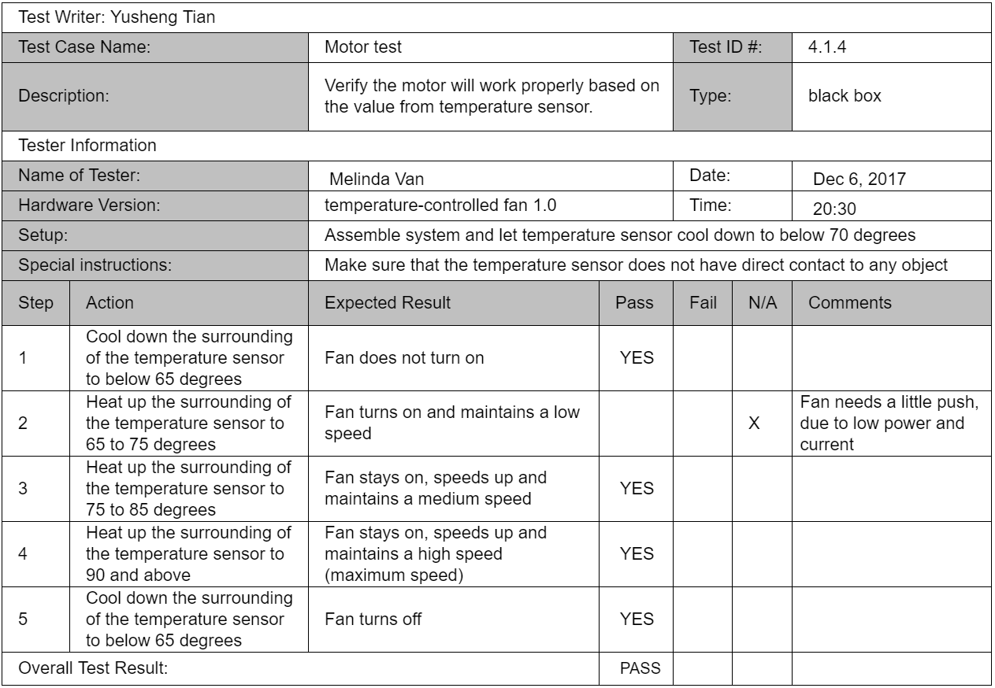
Test Case #1
Notes:
Team member #4

Slide 19
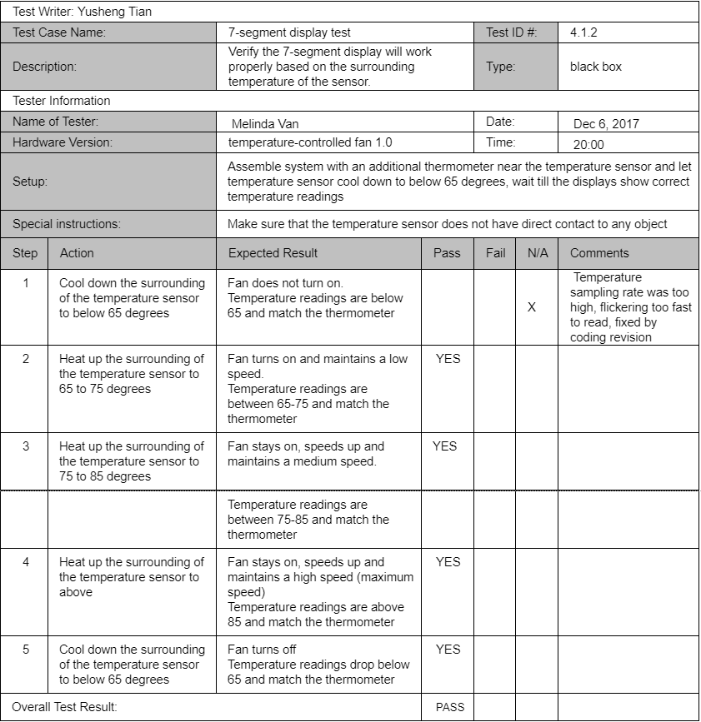
Test Case #2

Slide 20
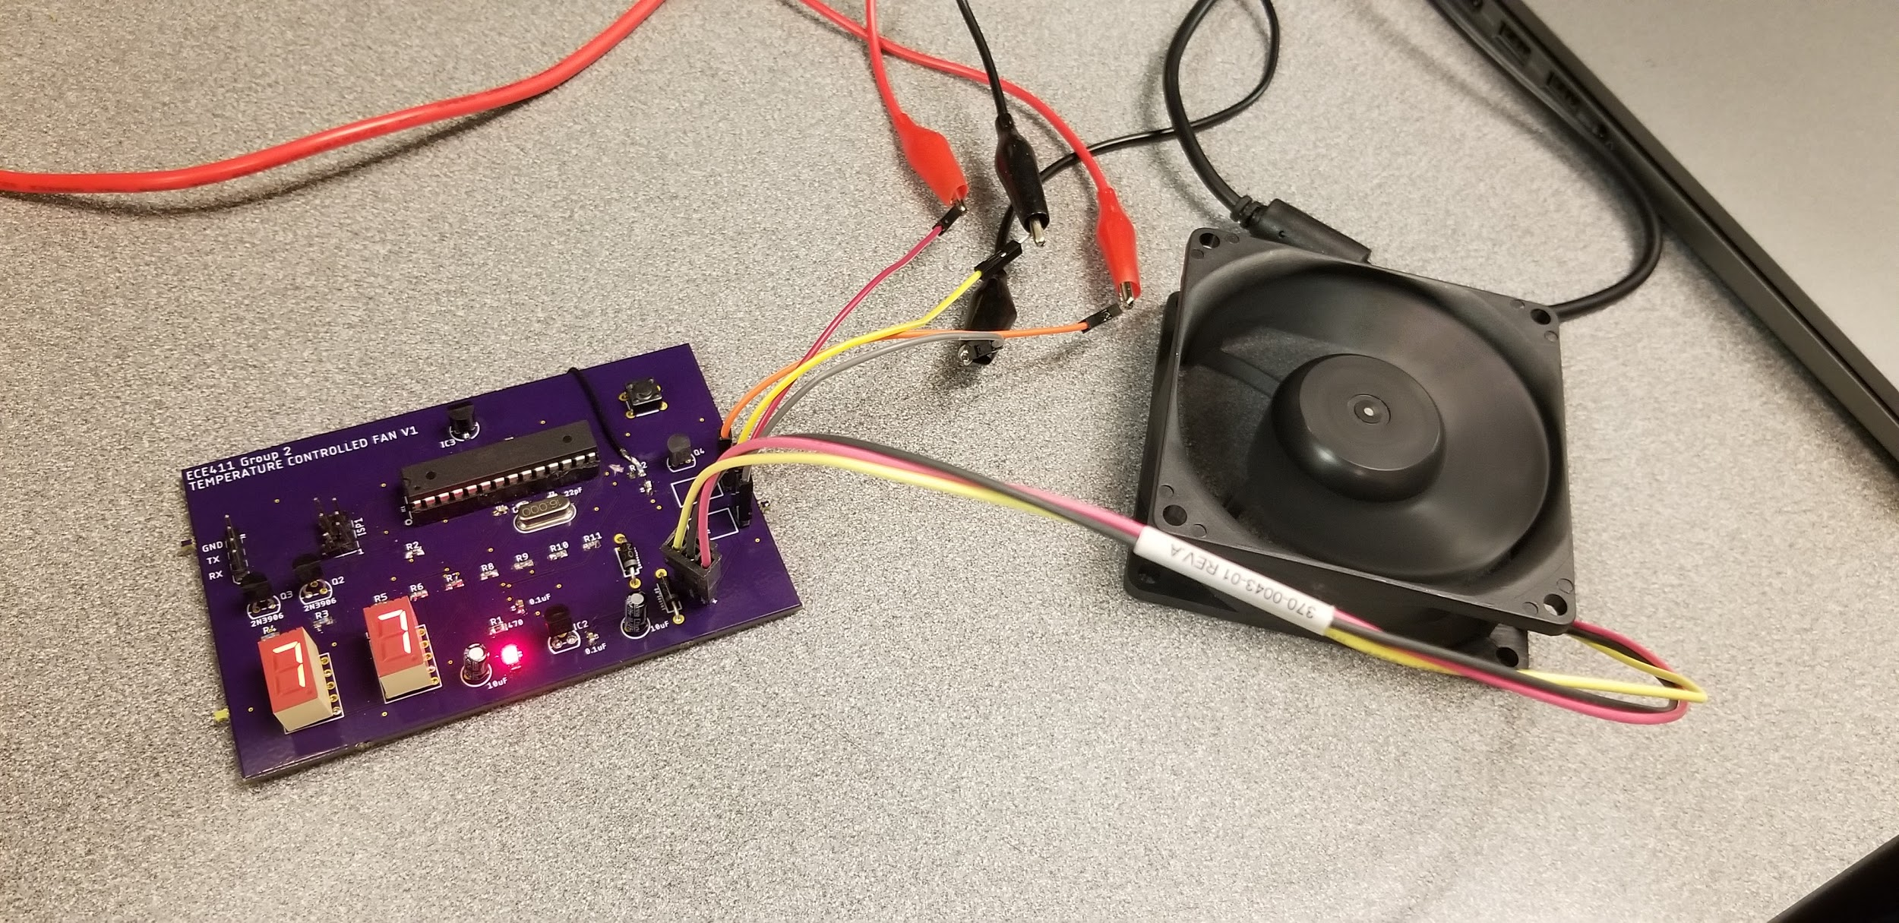
Completed Product
December 4th, 2017

Slide 21
Bill of Materials
Atmega328P | $5.00
LP2905-03BZ voltage regulator | $0.85
28-pin IC socket | $0.45
2 x 7-segment display | $3.00
12V DC fan | $2.00
2 x 9V battery | $6.00
LM35 temperature sensor | $1.20
Tactile button | $0.85
2 x rectifier diodes | $0.20
Surface mount components | $2.00
NPN transistors | $1.20
Total | $22.75
Notes:
Team member #3

Slide 22
Contributions
Ideas & Proposal | Reem, Yusheng
Hardware Design | Qiuren, Melinda
Software Development | Qiuren, Melinda
Collection/buying of Parts | All team members
Test Plan | Yusheng, Qiuren
PCB Prototype | Reem, Melinda, Yusheng
Testing | Reem, Melinda

Slide 23
Learning outcomes

Slide 24
Questions?

